Slide 1

Roseburn Primary School
Lagganlia
P7 Camp October 2019
Notes:
https://www.youtube.com/watch?v=acId5ftnjnE

Slide 2
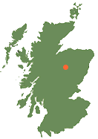
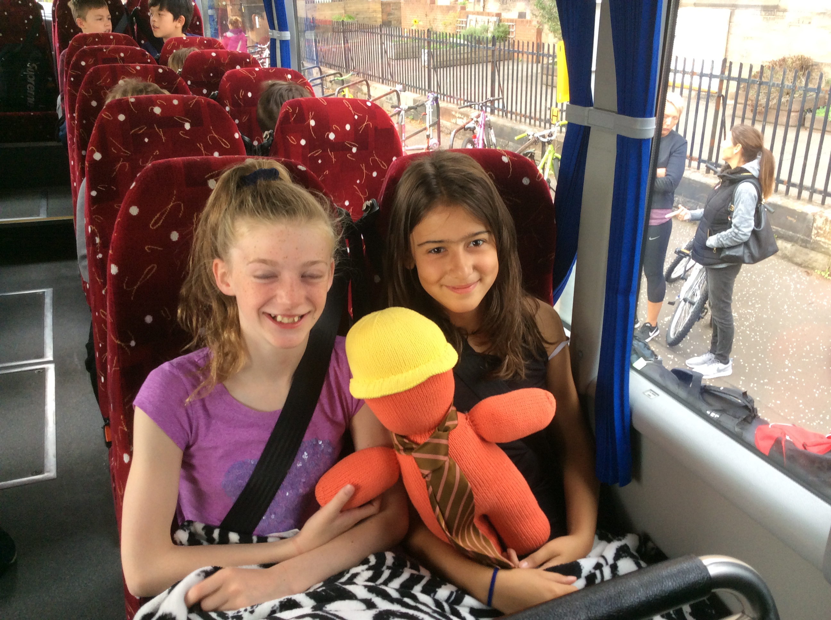
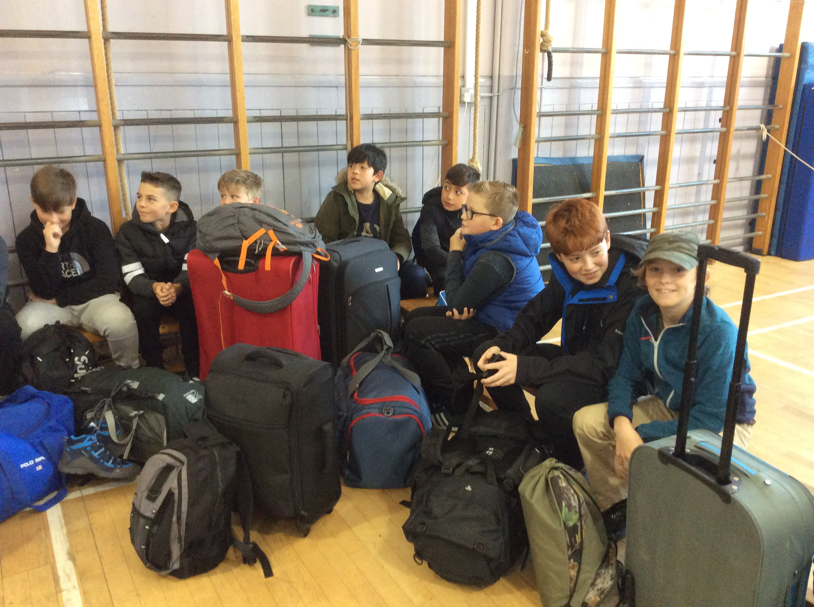
Lagganlia Cluster Camp
Welcome and Introduction
Aims
Informal meeting
Overview: Lagganlia Camp experience
What your child will expect to experience
Questions and Answers

Slide 3
Lagganlia Cluster Camp
Roseburn = 30 children and 3 staff
Corstorphine= 76 children and 7 staff
Hillwood =5 children and 1 staff
Neil Russell(Mon/Tues) Mrs Borrowman (Wed, Thur, Fri)
Mrs Reid and Mrs Thirgood all week.

Slide 4
Roseburn to Lagganlia
Parents and carers drop children at Roseburn between 8.15am-8.25am
Bus arrives at Roseburn
30 children and 3 staff depart from Roseburn at 8.30am approx
Pick up additional Corstorphine children and staff at 9am approx

Slide 5
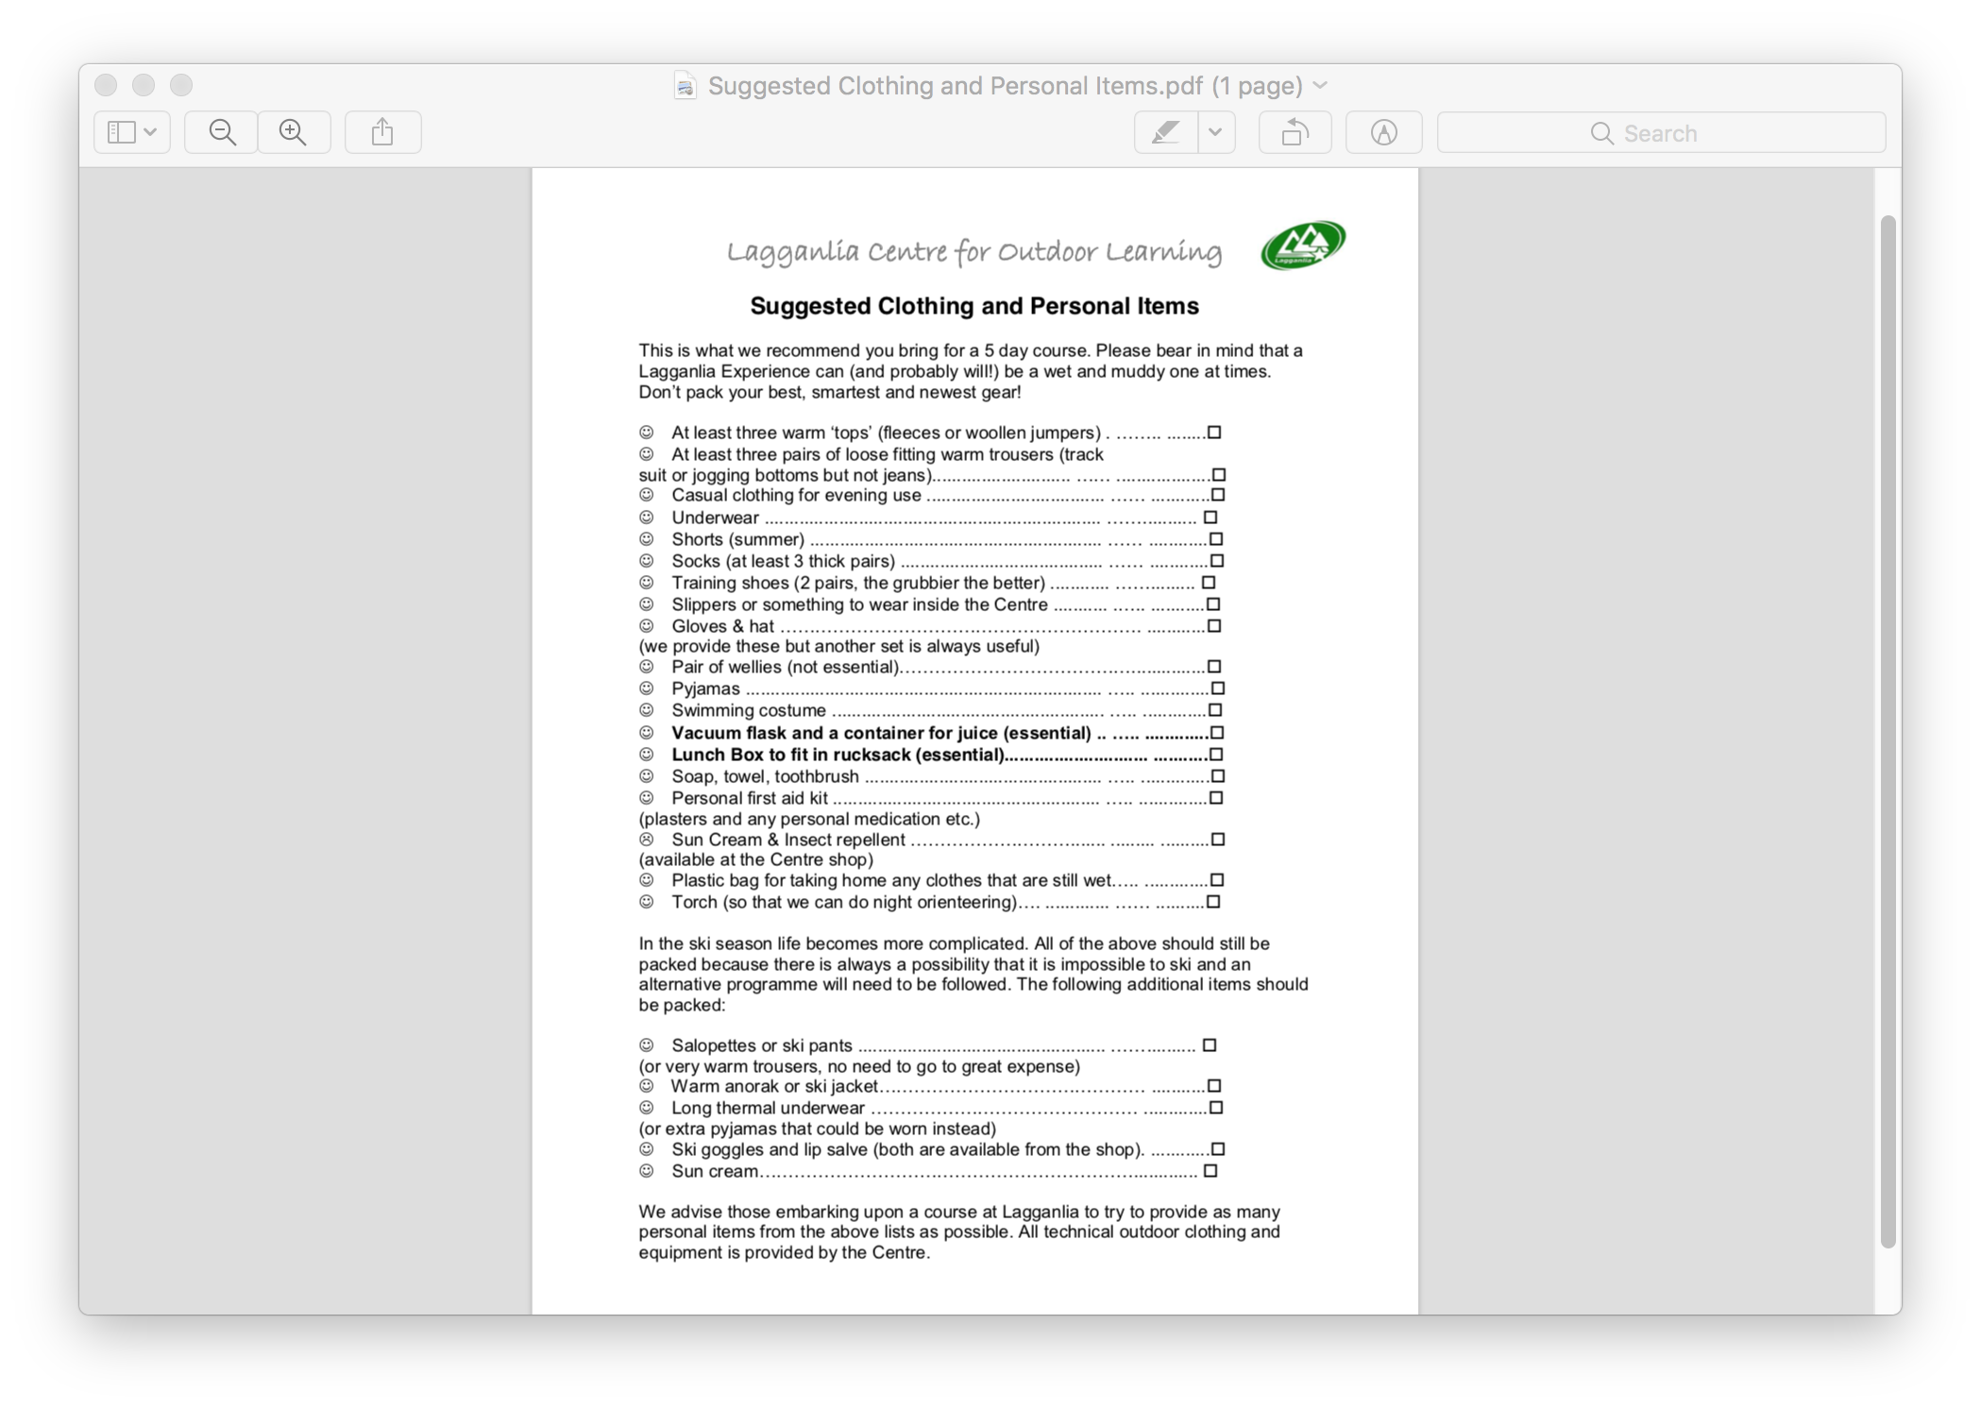
Packing for Lagganlia
On the bus
A small rucksack on bus with packed lunch and water bottle clearly labelled
  rain jacket and snack
  no snacks eaten on the bus
  cancel lunches with the office
No phones or electronic devices

Slide 6
Packing for Lagganlia
At Lagganlia
Large soft bag – can carry themselves
Please refer to kit list with all clothing and items named Bin Bag
No sleeping bags or duvets
Midge spray named
JASS Award
Up to £5 in coins for gift shop.
Money in named purse
No need to send any snacks
To practice: No fitted sheets
Duvets go in a duvet cover
Hanging washing

Slide 7
Practical Information for Lagganlia
Thank you …the paperwork
Leaving: Meet in Gym Hall
Medication bring on Monday with KIC medical forms
If you want to bring it in on Friday
Doors open at 8.15am in Gym Hall, drop off bags
Staff register children
Staff bring children out coach outside school about 8.30am (say farewells)
Stop in Pitlochry for toilet stop / snack
Children find out about dorms activity groups on the journey there (we have taken everything into consideration and used their lists )
Arrive at Lagganlia about 1pm unload the bus . Children meet in Main Building and meet instructors
Coming Home: Leave Lagganlia between 10-10.30am.
Will tweet/ message when approaching Queensferry Crossing – back about 1.30pm

Slide 8
Activity Groups at Lagganlia
11 Day Activity Groups
Each Group will have own school children
Roseburn will have 3 Groups
11 Evening Activity Groups
Roseburn groups will have some Corstorphine and Hillwood children
Evening meals are eaten in evening activity groups

Slide 9
Activity Groups at Lagganlia
11 Day Activity Groups
Each Group meets with their instructor
Activities are determined in collaboration with the group and by weather, interest and ability

Slide 10
Activity Groups at Lagganlia
11 Evening Activity Groups
Suggested activities are:
4.30-5.30pm- diary writing/free time each night
5.30-6.30pm dinner or 6.30-7.30pm dinner
Evening activities 7.30-9pm
Mon: Scatter course,
Tues: games evening,
Wed: Night line adventure
Thurs: Camp fire
Fri: pack and tick off kit list, black bag dirties/wet

Slide 11
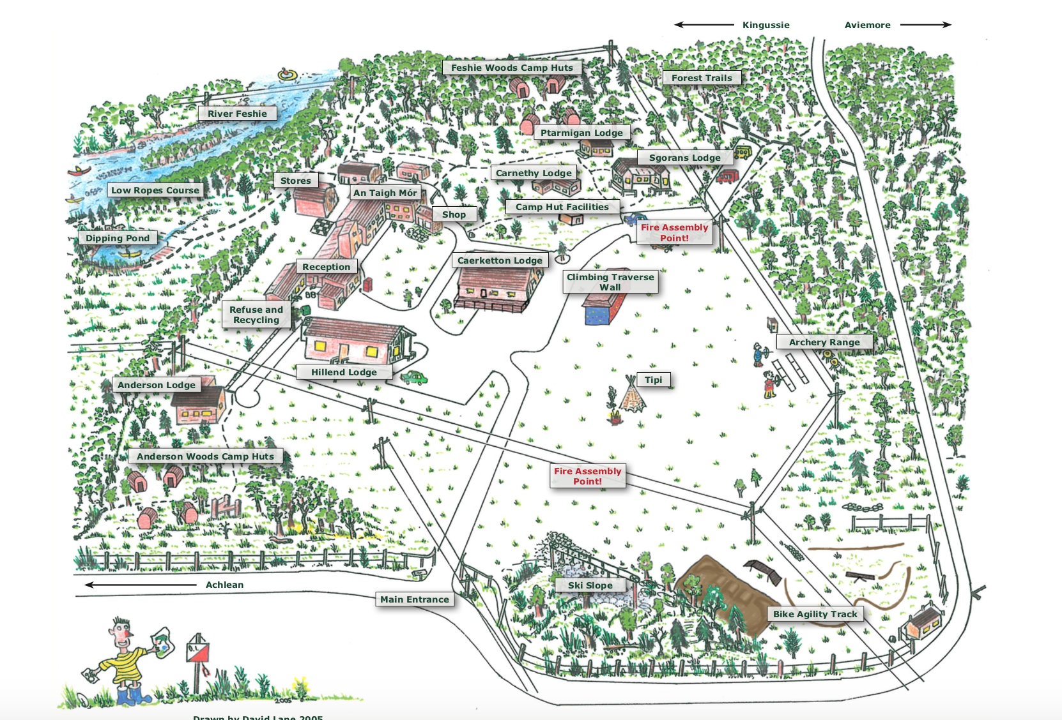
Lagganlia Grounds

Slide 12
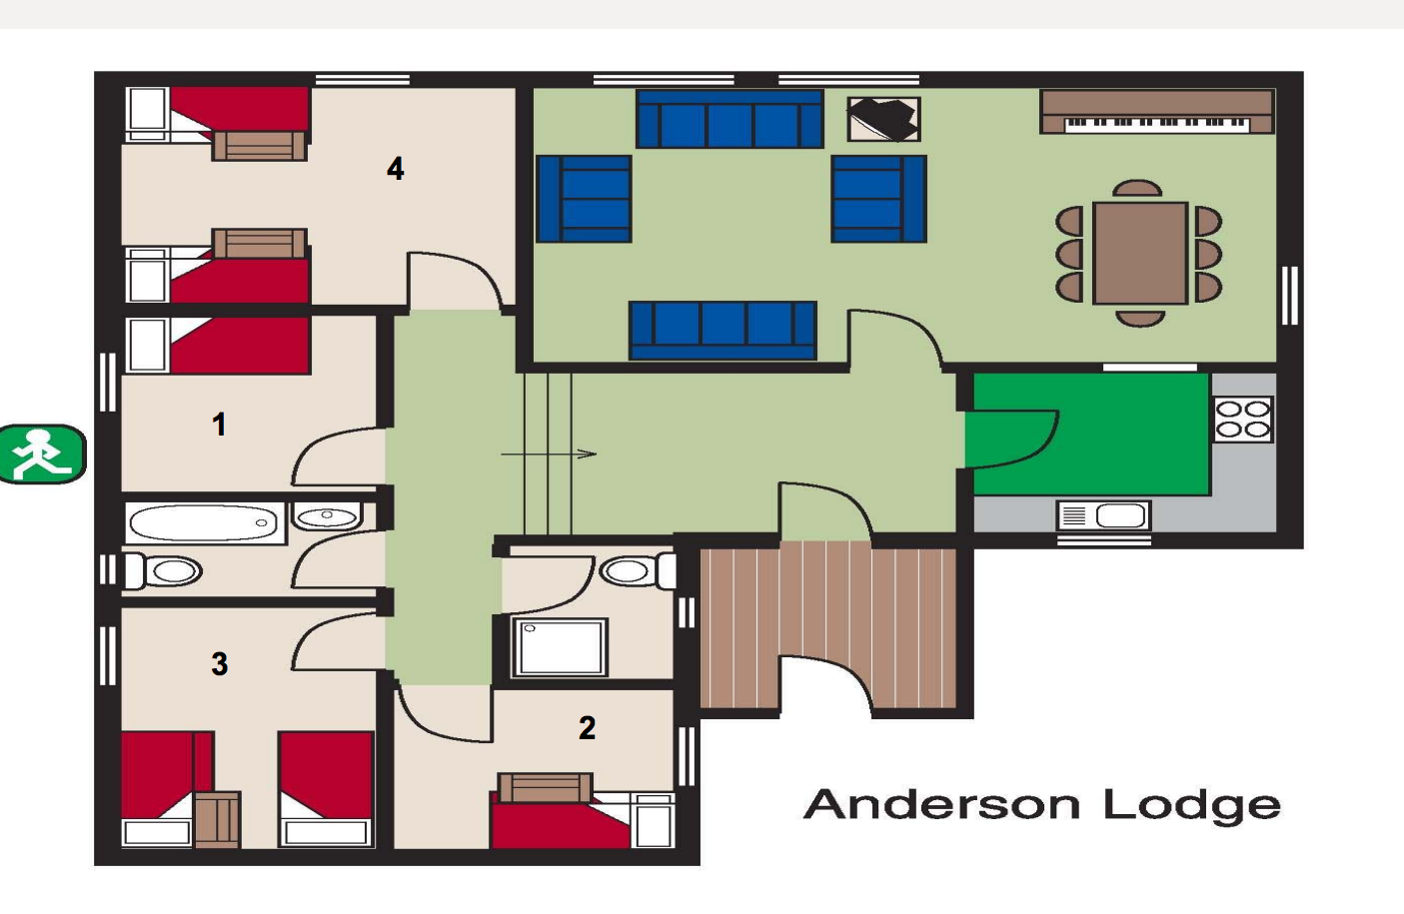
Lagganlia
Anderson Lodge
The boys

Slide 13
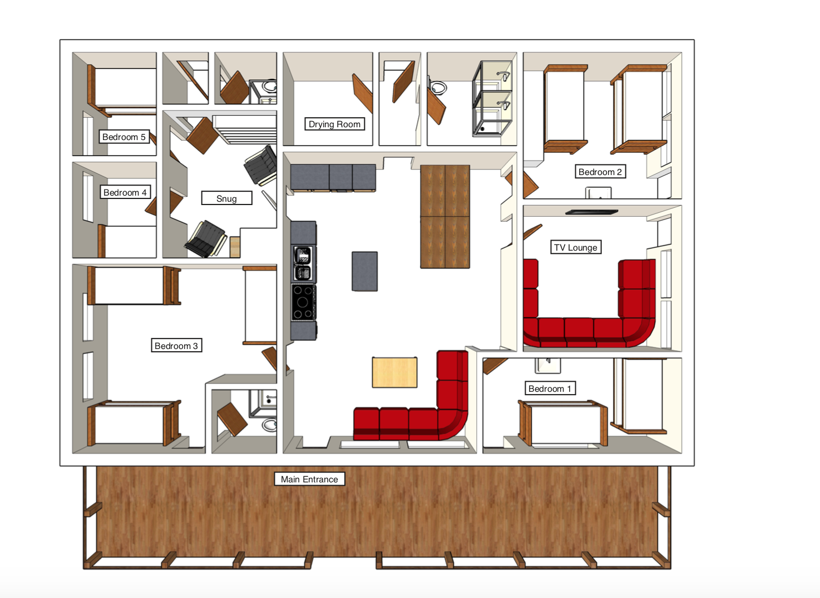
Lagganlia
Caerketton Lodge
The
girls

Slide 14
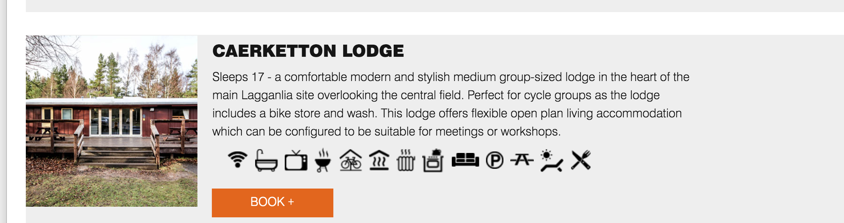
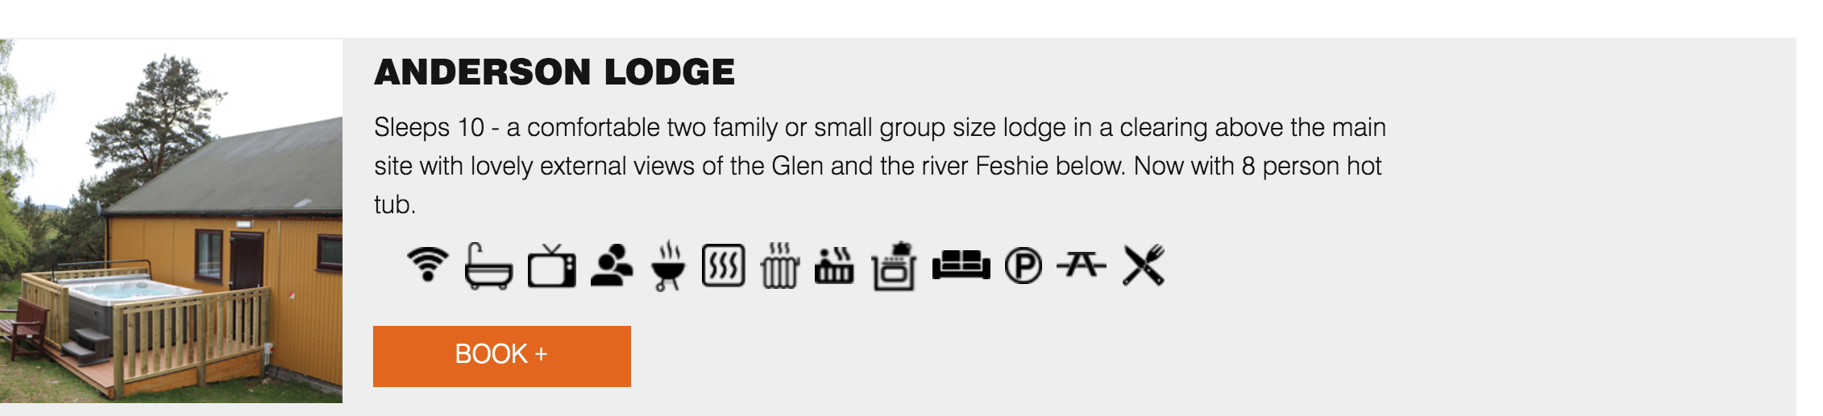
The Lodges

Slide 15
Still Learning but
outdoors…
The 4 Capacities
Successful learners
Confident individuals
Responsible citizens
Effective contributors
And Building Resilience

Slide 16

Lagganlia
P7 experience
Notes:
https://youtu.be/DuhnC8xH03M

Slide 17
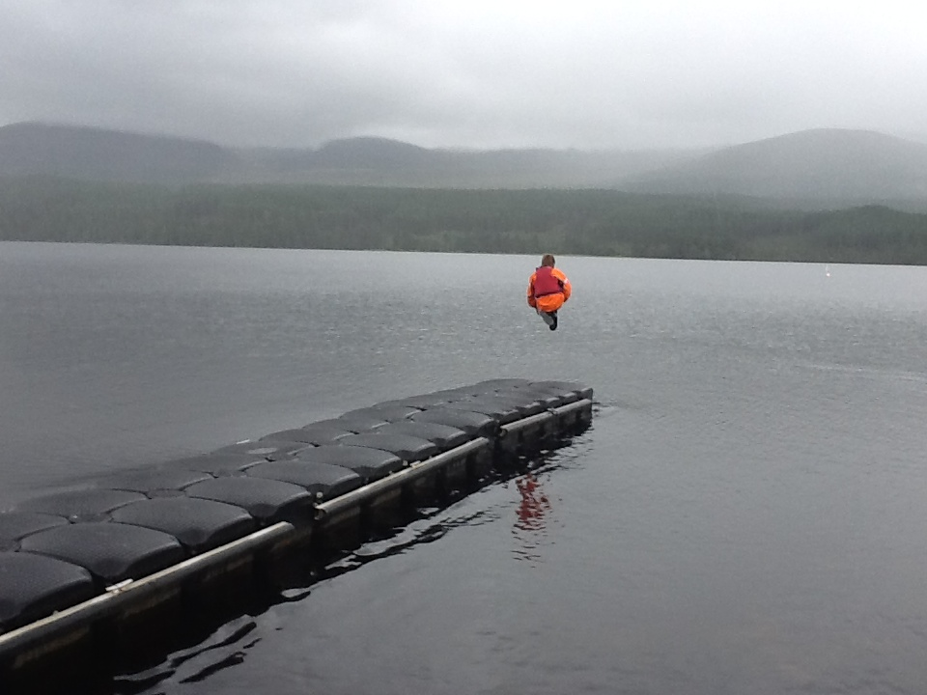
An unforgettable experience…
Additional questions
https://www.youtube.com/watch?v=DuhnC8xH03M
Notes:
https://www.youtube.com/watch?v=N3qyLKI8-vo

