Slide 1
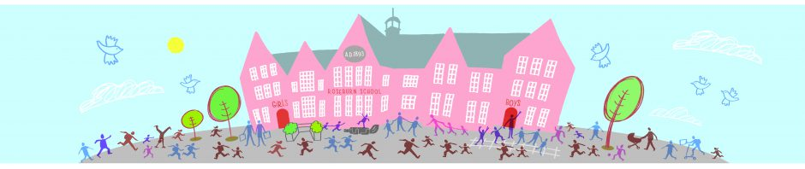
Roseburn Primary School
Week One
Nursery Home Leaning

Slide 2
Week One
We are super proud of all that you have achieved last week. The following are a selection of activities that the nursery boys and girls enjoyed.

Slide 3
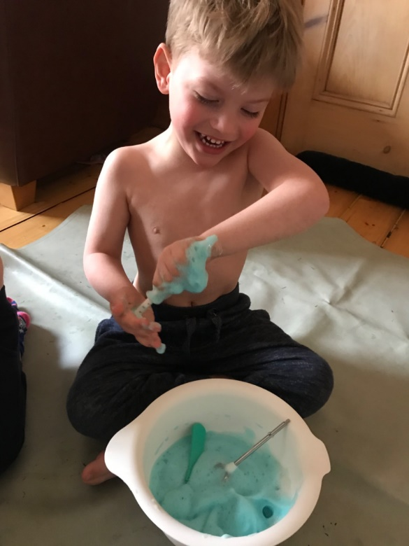
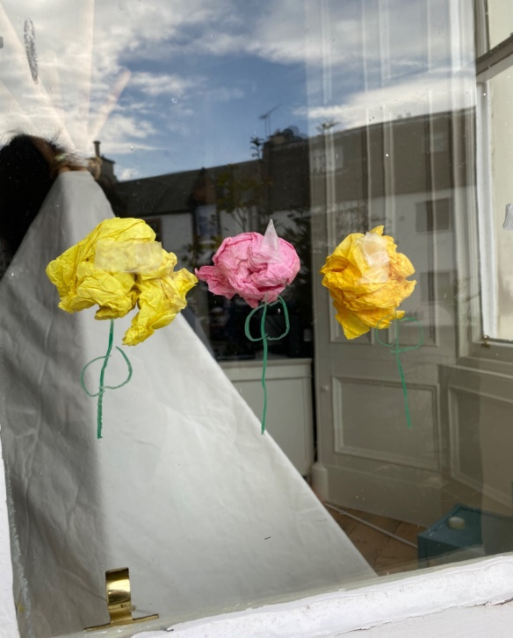
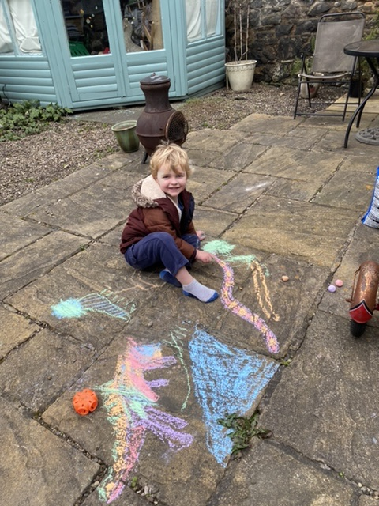
We were Creative

Slide 4
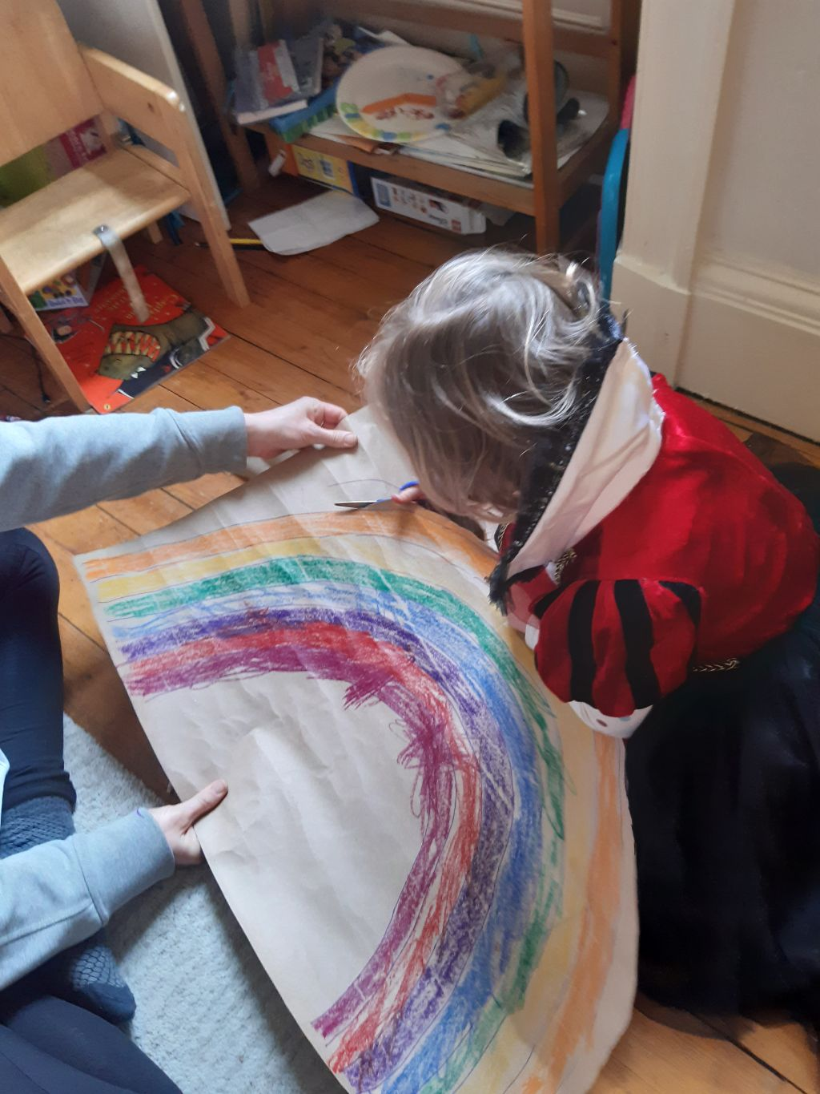
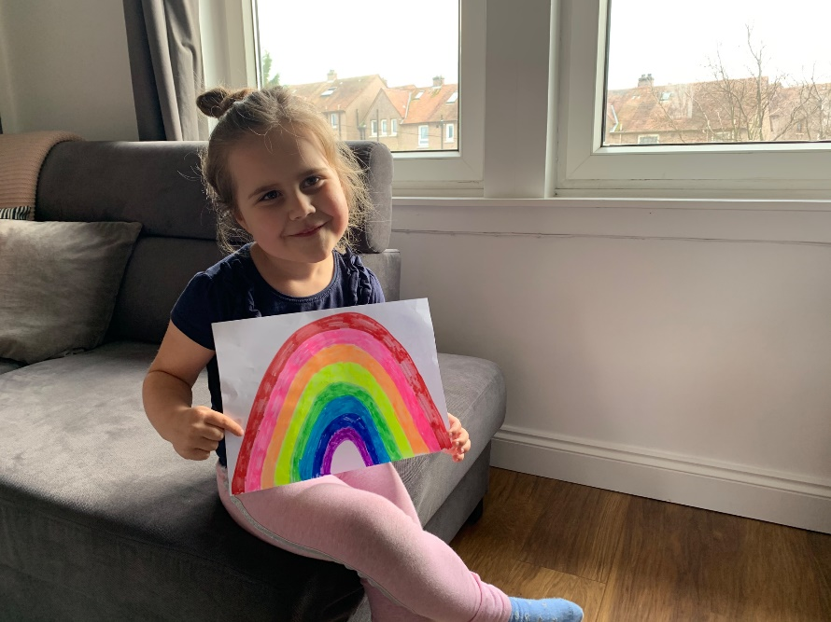
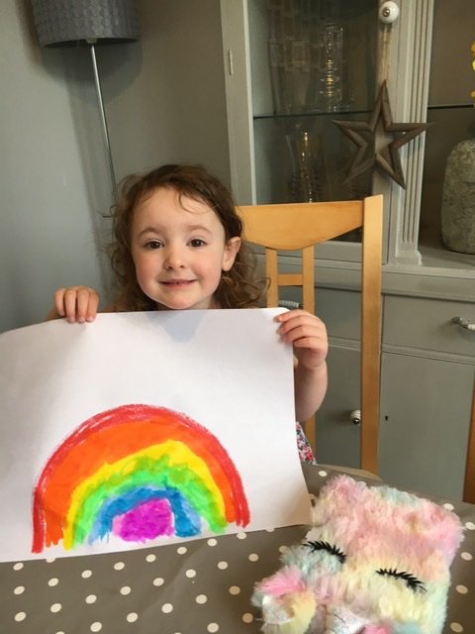
We painted rainbows

Slide 5
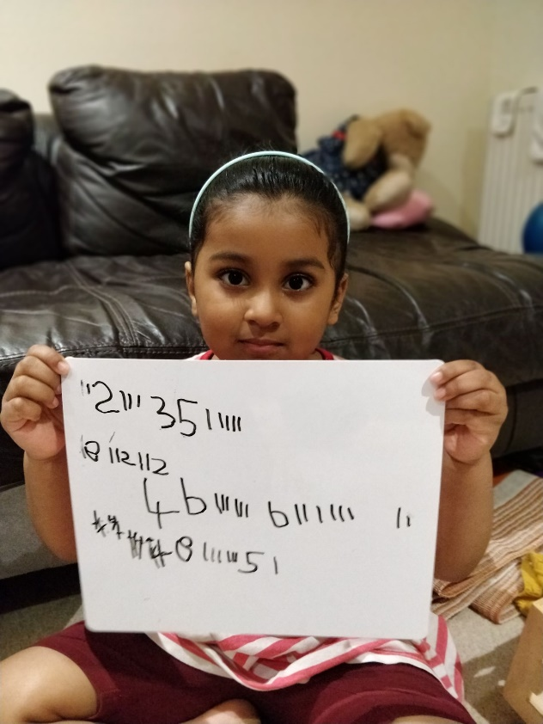
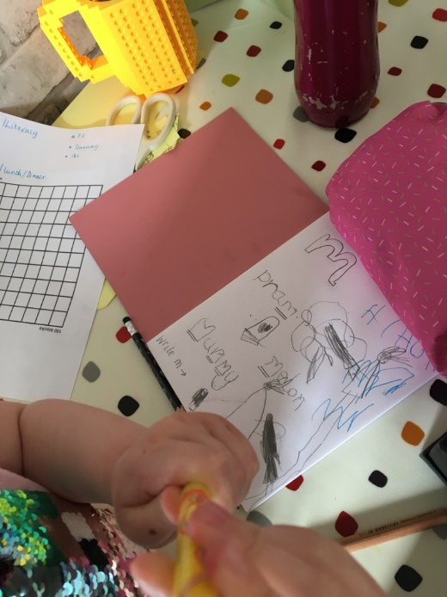
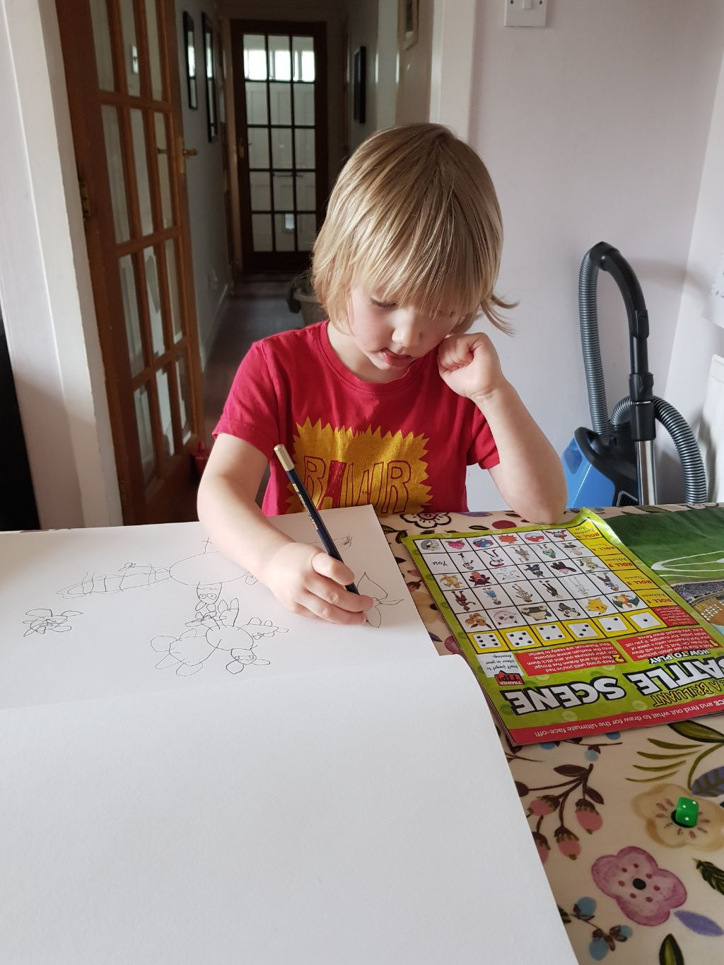
We took our activities very seriously

Slide 6
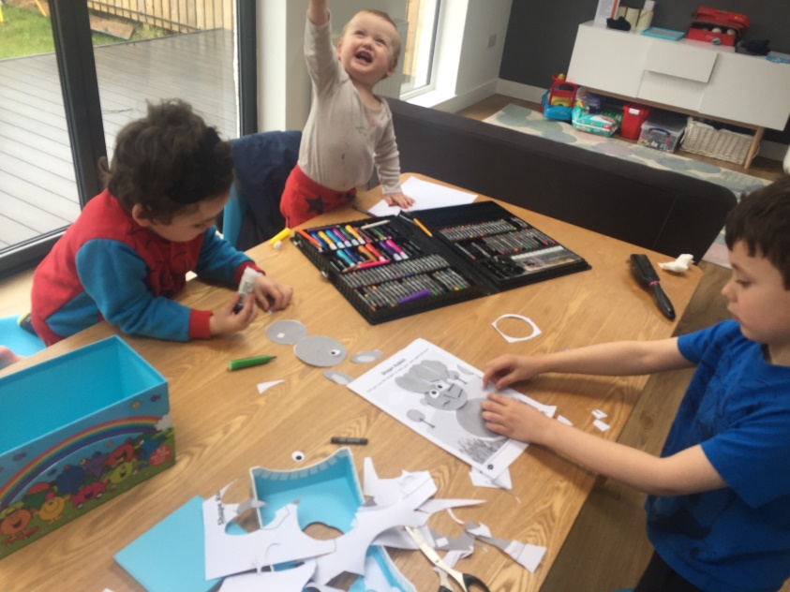
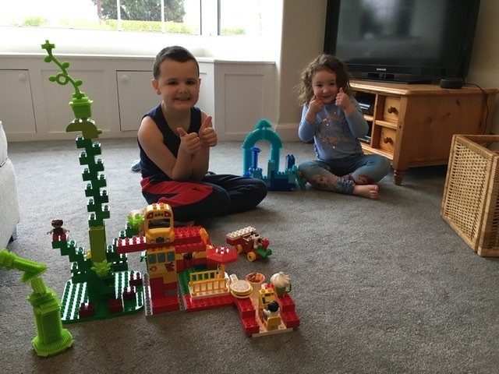
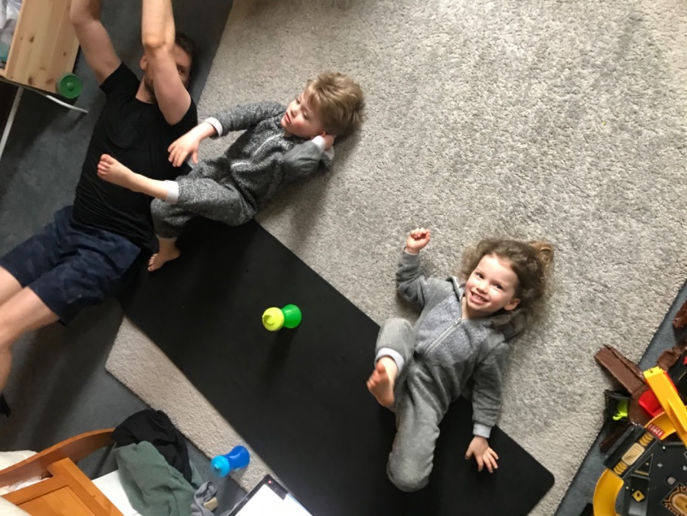
We worked together
Notes:
.

Slide 7
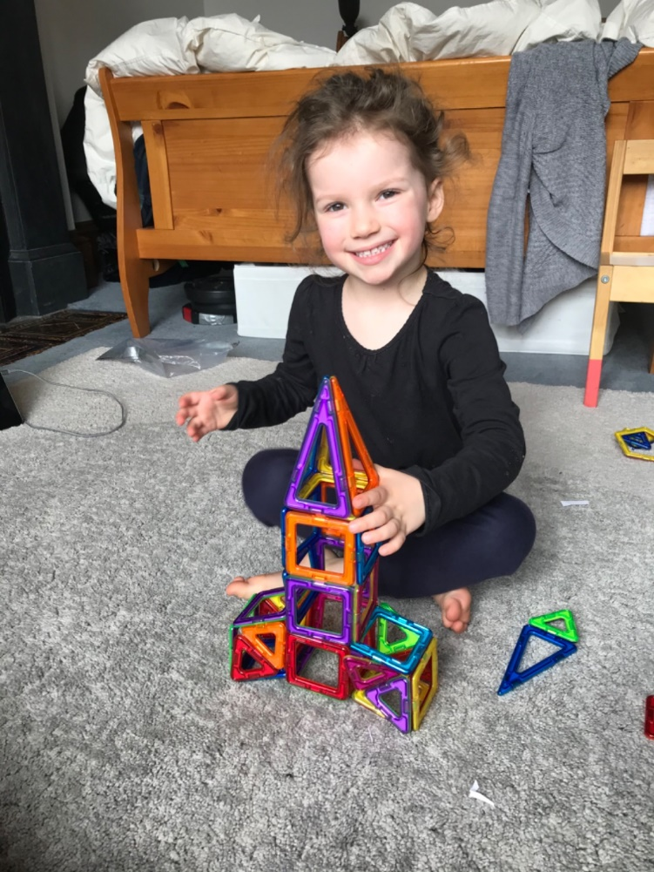
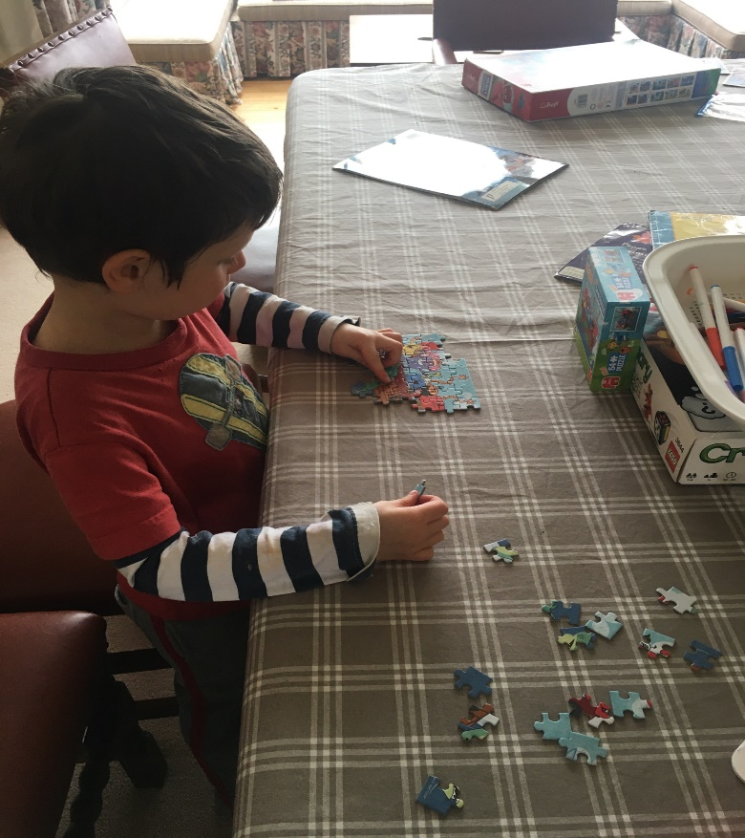
First Level
Names of parts of my body
My body belongs to me
My friends/Being a friend
Kindness and Empathy
When friends fall out
Looking after plants and animals
Learning about life cycles
Looking after pets
People who help and look after me
People who are special to me
When I have a question or worry
Professional People
My family/All our families are different
This is how I feel
Feeling safe
Similarity, diversity and respect
I am unique: My self portrait
We are similar and different
Boys and Girls
Disability
Heterosexual/LGB
Keeping clean
Safe and happy online
How human life begins, pregnancy and birth
How human life begins, pregnancy and birth What babies need
Jigsaws and building

Slide 8
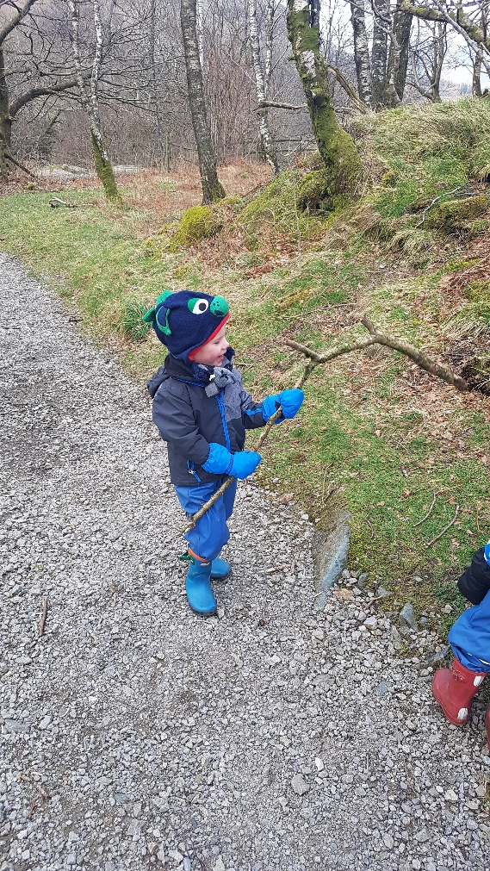
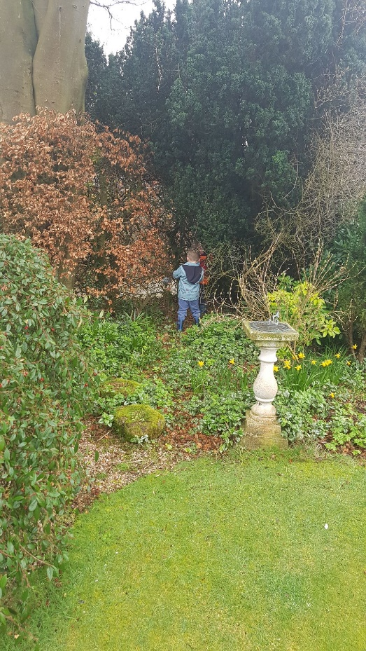
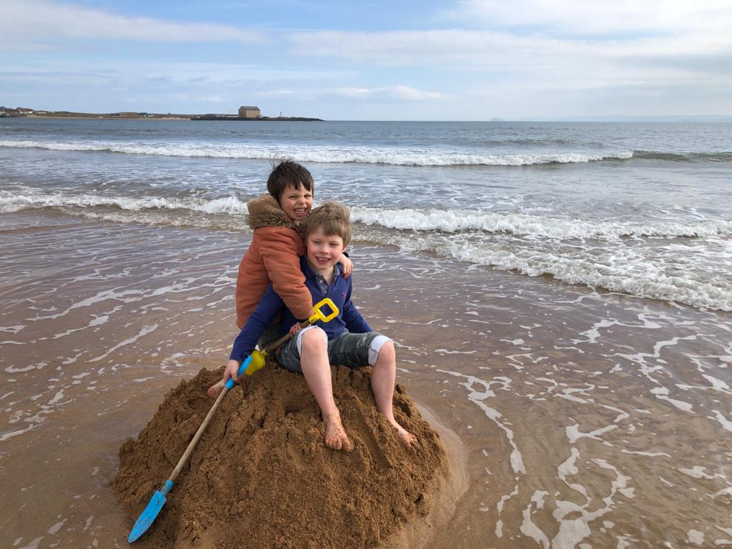
We enjoyed the fresh air

Slide 9
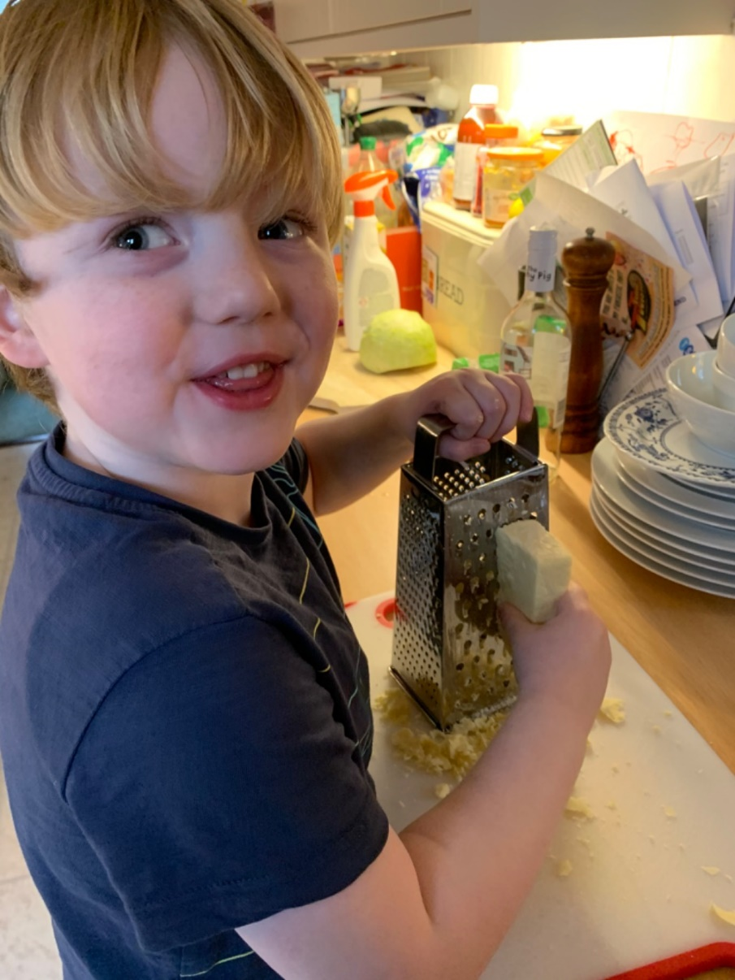
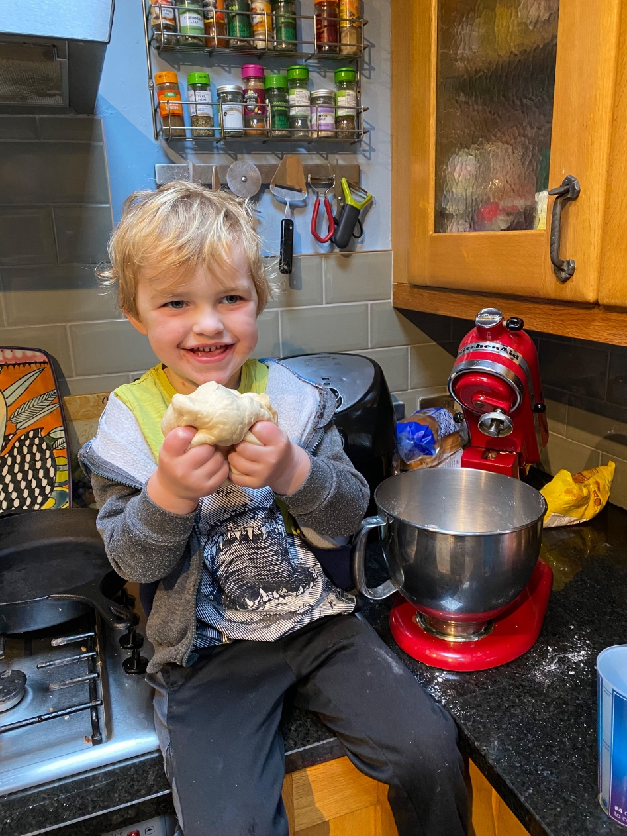
We cooked and baked

Slide 10
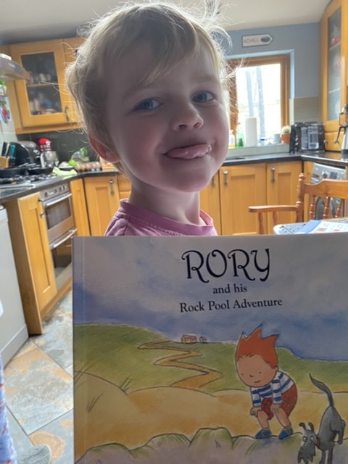
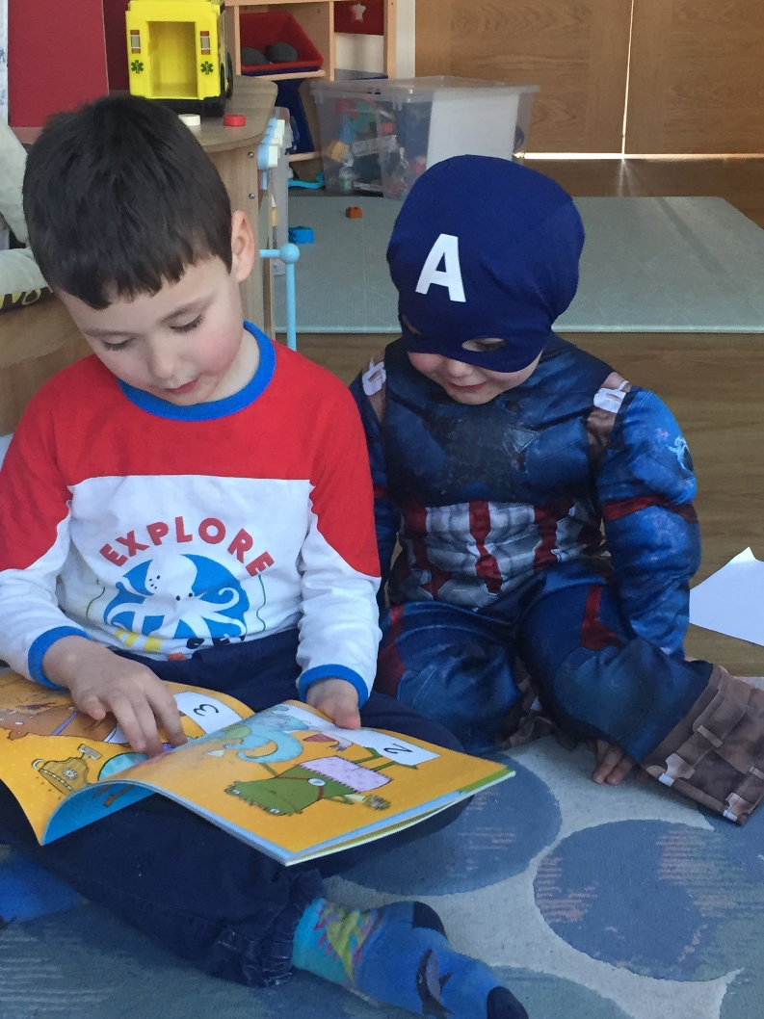
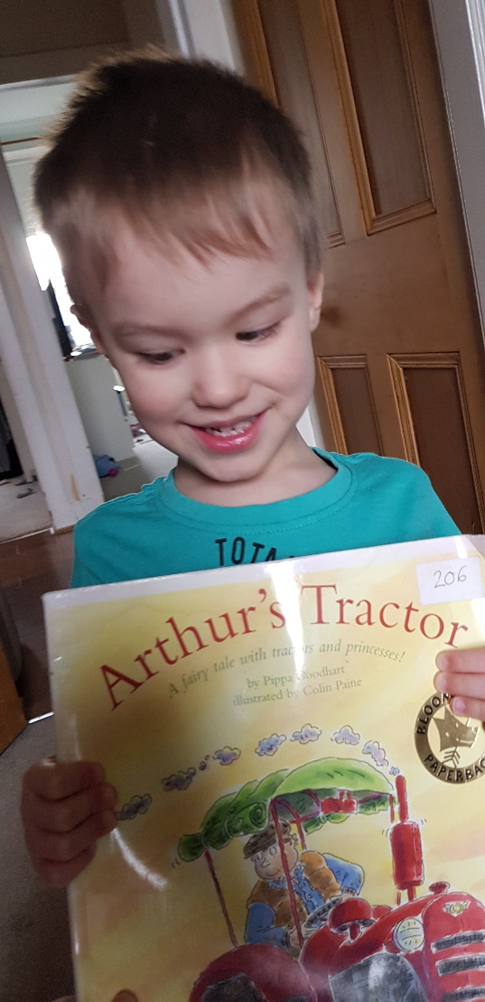
We read our books

Slide 11
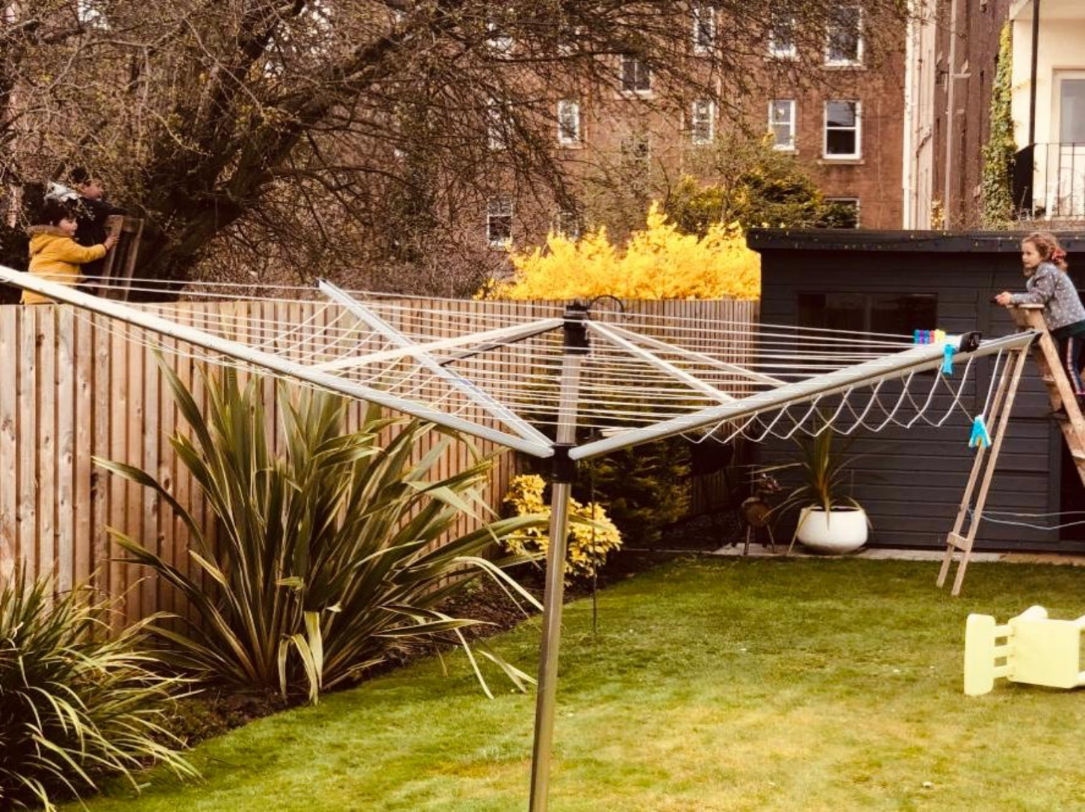
We learnt all about Social Distancing?

Slide 12
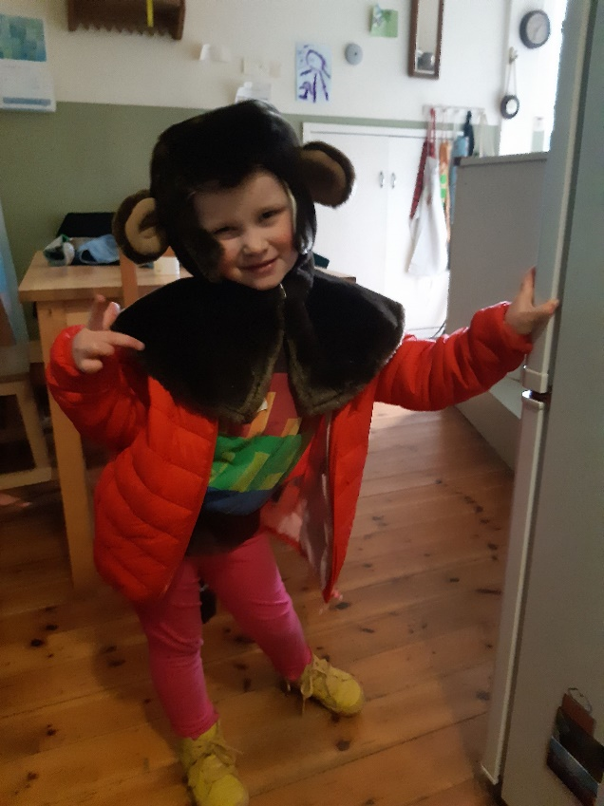
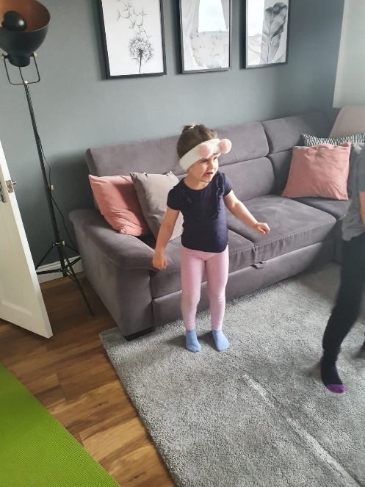
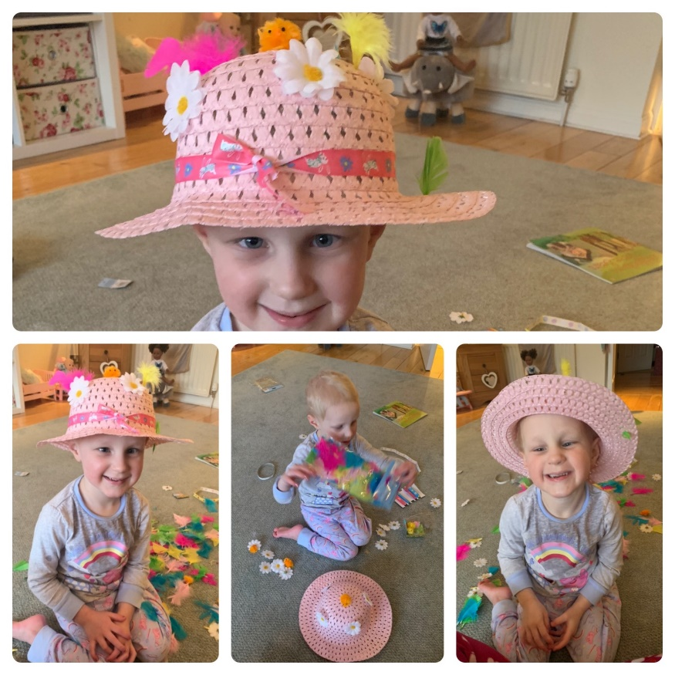
And we had fun, so thank you for sharing

