Slide 1

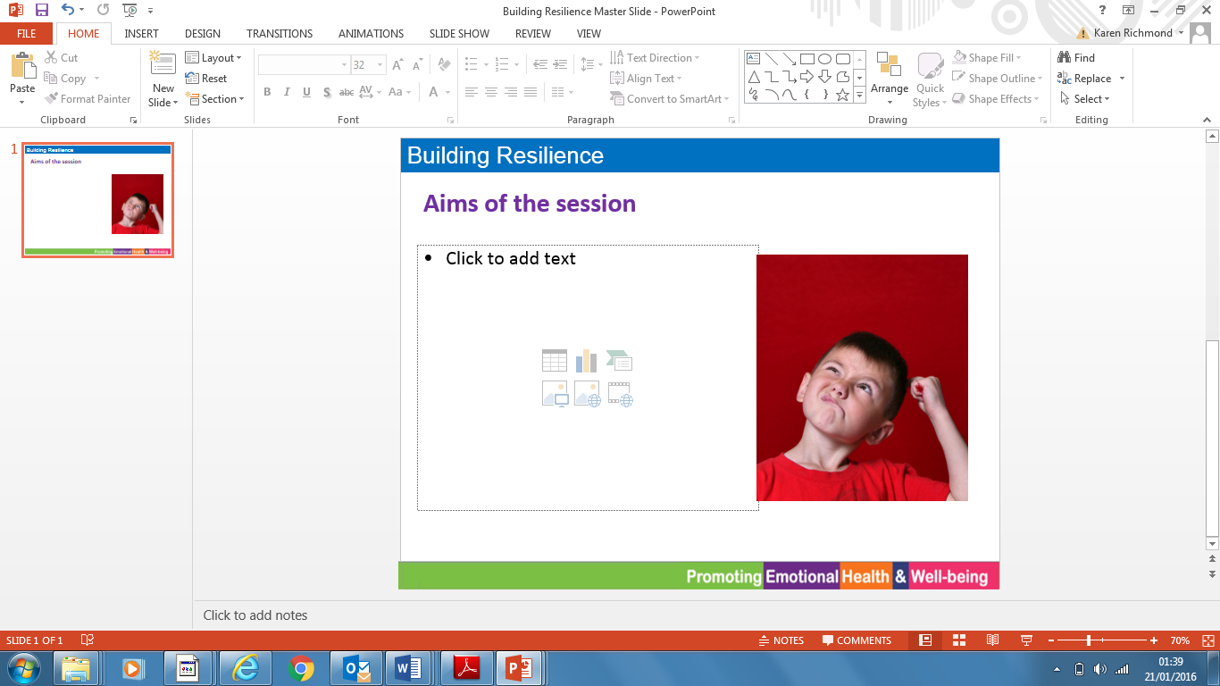
Parent & Carer Guide
Parent & Carer Guide
“A boat is safe in the harbour,
but that’s not what boats are for.”
Anon.
“A boat is safe in the harbour,
but that’s not what boats are for.”
Anon.
Notes:
Wording should read DEVELOP ‘EMOTIONAL’ RESILIENCE

Slide 2

Be Resilient
Resilience is a key factor in protecting and promoting good mental health. While we can’t always predict what life throws at us, the good news is there are a range of different skills, strategies and resources that can help us to cope.
In this unit, pupils will be introduced to a character called Skipper. Skipper, is the captain of his boat that travels down the river of life, like everyone he goes through various ups and downs on his journey.
On his way, Skipper will introduce the children to ten things that help us to navigate the river of life and support the development of resilience. These things include the importance of positive relationships and role models, the development of good social and emotional skills, participating in activities, having hobbies and interests and a sense of meaning and belonging.
In this unit, we will be learning that:
Everyone goes through ups and downs in their life
We can learn to be more resilient
Resilient people cope better with difficulties
Talk it Over:
Share with your child an example of when you have gone through a difficult time. How did you feel? Who or what helped you to get through it.
Family Task:
Create a poster of someone who has come through a difficult time. Label your poster with things that has helped them get through difficult times.
Key Book: ‘Oh, the places you go’ by Dr Seuss
Be Resilient
Resilience is a key factor in protecting and promoting good mental health. While we can’t always predict what life throws at us, the good news is there are a range of different skills, strategies and resources that can help us to cope.
In this unit, pupils will be introduced to a character called Skipper. Skipper, is the captain of his boat that travels down the river of life, like everyone he goes through various ups and downs on his journey.
On his way, Skipper will introduce the children to ten things that help us to navigate the river of life and support the development of resilience. These things include the importance of positive relationships and role models, the development of good social and emotional skills, participating in activities, having hobbies and interests and a sense of meaning and belonging.
In this unit, we will be learning that:
Everyone goes through ups and downs in their life
We can learn to be more resilient
Resilient people cope better with difficulties
Talk it Over:
Share with your child an example of when you have gone through a difficult time. How did you feel? Who or what helped you to get through it.
Family Task:
Create a poster of someone who has come through a difficult time. Label your poster with things that has helped them get through difficult times.
Key Book: ‘Oh, the places you go’ by Dr Seuss

