Slide 1
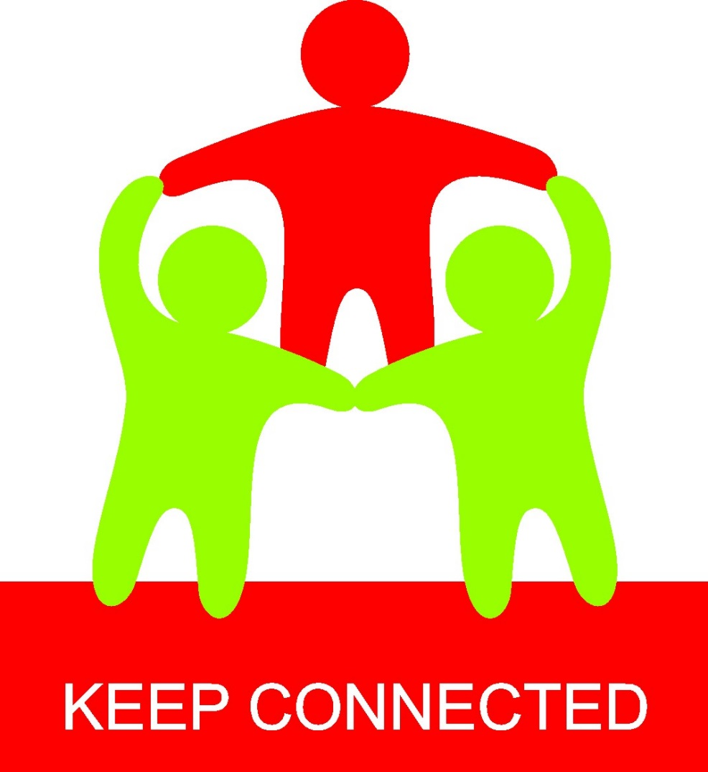
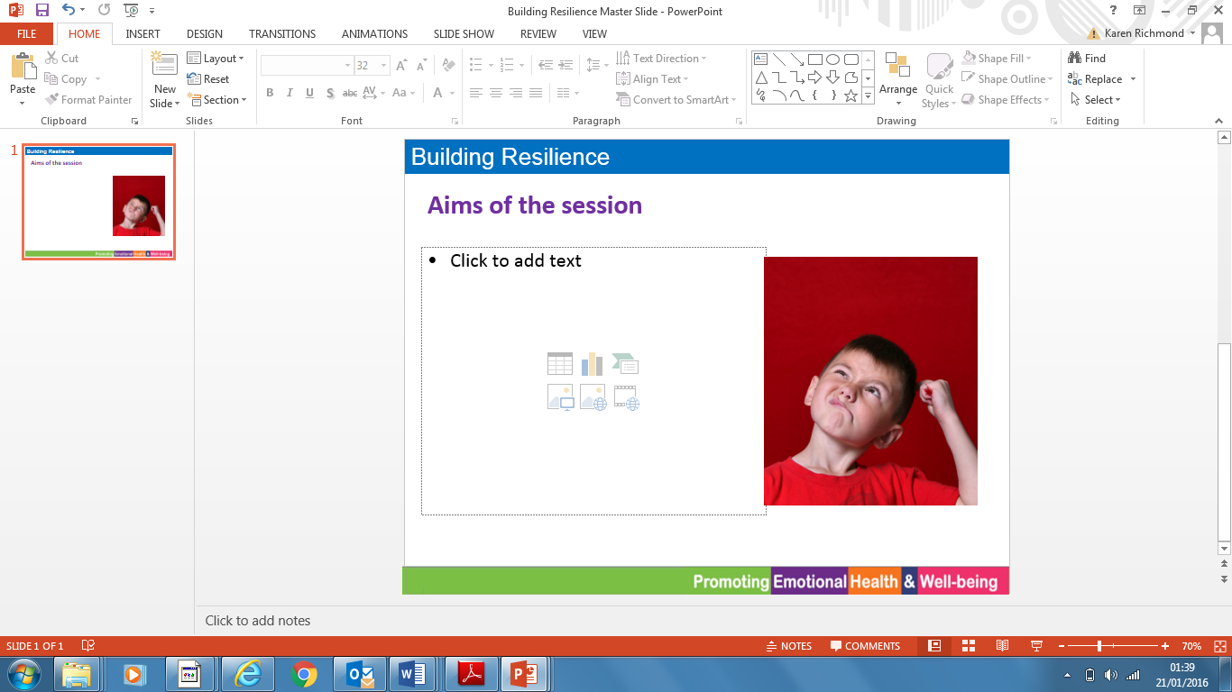
Parent & Carer Guide
Parent & Carer Guide
“There is nothing better than a friend,
unless it is a friend with chocolate.”
Linda Grayson
“There is nothing better than a friend,
unless it is a friend with chocolate.”
Linda Grayson

Slide 2
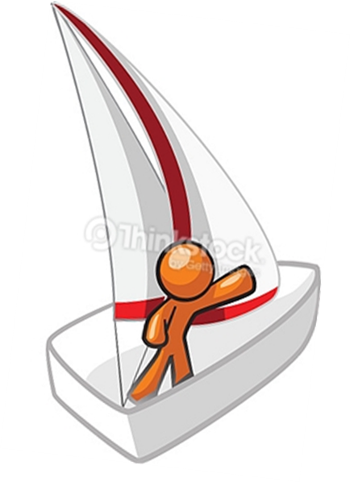
Keep Connected
In general, people with caring and positive relationships are happier, healthier and live longer. Close relationships with family and friends provide love, meaning, support, and an increase in our feelings of self-worth and our sense of belonging. Having caring and positive relationships is one of the most important factors of our ability to cope with life’s ups and downs.
During this unit, the children will be thinking about people who are special to them. They can be people we see regularly or not very often, young or old, family, friends or anyone we come into contact with in our school or our community.
Skipper helps the children to learn how to be more resilient. In this unit Skipper gets his boat stuck in the reeds at night and can’t see a way out without some help from his Back Up Team. Skipper explains that we need to work at building up a strong Back Up Team of people who we trust to be there for us through the ups and downs.
In this unit, we will be learning that:
Relationships are important for our health and wellbeing
Belonging to a group can be a good way to build friendships.
Good relationships are a two way thing.
Talk it Over:
Share with your child the people who are in your Back Up Team.
Family Task:
Who is in your Back Up Team? Create a Team Sheet of the important people in your life. What makes them special to you?
You can add drawings/photographs of each person.
Key Book: ‘The Snail and the Whale’ by Julia Donaldson
Keep Connected
In general, people with caring and positive relationships are happier, healthier and live longer. Close relationships with family and friends provide love, meaning, support, and an increase in our feelings of self-worth and our sense of belonging. Having caring and positive relationships is one of the most important factors of our ability to cope with life’s ups and downs.
During this unit, the children will be thinking about people who are special to them. They can be people we see regularly or not very often, young or old, family, friends or anyone we come into contact with in our school or our community.
Skipper helps the children to learn how to be more resilient. In this unit Skipper gets his boat stuck in the reeds at night and can’t see a way out without some help from his Back Up Team. Skipper explains that we need to work at building up a strong Back Up Team of people who we trust to be there for us through the ups and downs.
In this unit, we will be learning that:
Relationships are important for our health and wellbeing
Belonging to a group can be a good way to build friendships.
Good relationships are a two way thing.
Talk it Over:
Share with your child the people who are in your Back Up Team.
Family Task:
Who is in your Back Up Team? Create a Team Sheet of the important people in your life. What makes them special to you?
You can add drawings/photographs of each person.
Key Book: ‘The Snail and the Whale’ by Julia Donaldson

